Slide 1
GitHub Repository - Team 2
Submitted by:
Devanshi Trivedi (013530530)
Keerthi Akella (013858819)
Nithin Gollanapally (013820599)
Thinh Manh(012050571)
Rajesh Thummala (013829179)
Siddarth Varanasi (013854295)

Slide 2
Project Introduction
Application is a version control tool for coders and developers.
Many times, it happens that the programmer wants to revert to a change he made. Commit comes in.
Coders can also follow each other and can be inspired by others work.

Slide 3
Technologies
Database engine: MySQL
DB application technologies: JDBC, JAVA, Log 4J
Languages: Java
DB access technology: JDBC 6.0

Slide 4
Functionalities
1) User Login
Sign Up and Login
Creates and View Repository
Creates and View Branches
Creates and View Project Files
Select a branch
Creates and View Commits
Creates and View Pull Requests
Follow a user
View followers and following
2) Admin Login
Delete user, repository,
Rename Repository and Branch
3) Transactions and Logs

Slide 5
Objects
Actors/ Roles
User
Admin
Users
Repositories
Project Files
Branches
Pull Requests
Commits

Slide 6
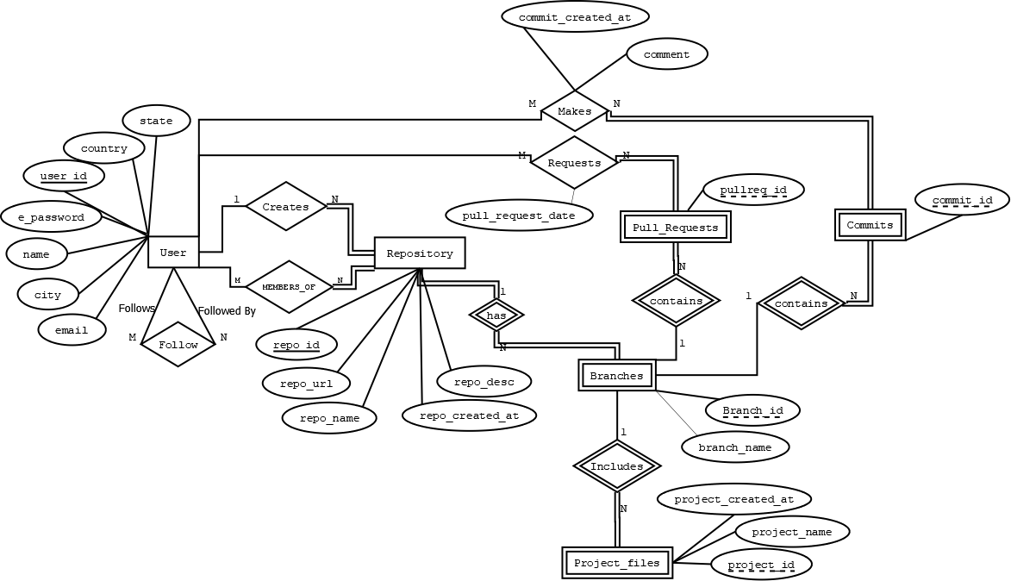
ER Diagram

Slide 7
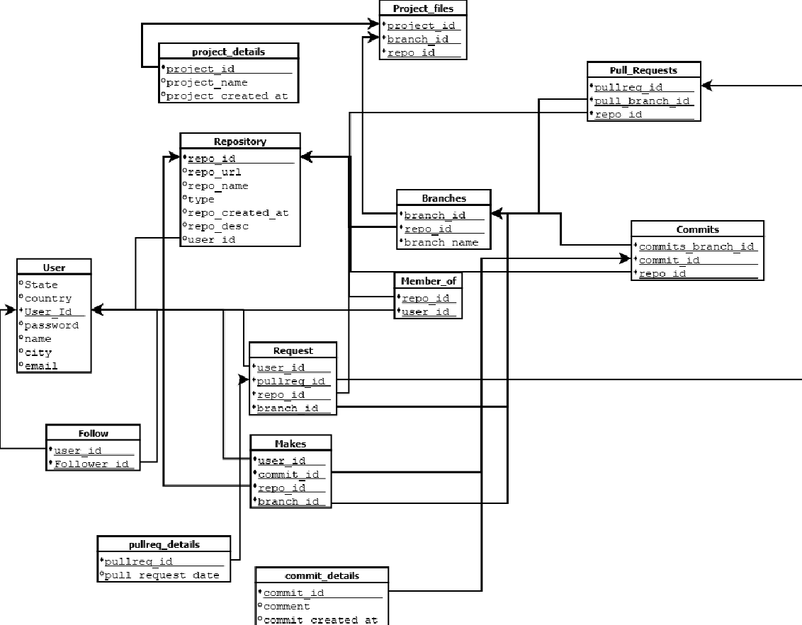
Schema Diagram
All the tables are in 3rd normal form

Slide 8
Additional Features :
Transactions
Implemented transactions in all the functionalities which involves DML operations.
Password Encryption
Encrypted user input password using MD5 Algorithm.
Log File
Implemented log4j feature using Apache log which can log all the operations.

Slide 9
Questions?

Slide 10
Thank You

